Slide 1

Fundamental of JAVA Programming
UNIT :- IV
Interface and Packages in JAVA

Slide 2
Packages
Java two most innovative features are packages and Interfaces
Package is the set of collection of classes and / or interfaces
It act as a container for classes that are used.
Why Packages ?
Limitation to reusing the classes within a program
If we need to use classes from other programs without physically copying them into the program under development?

Slide 3
Advantages of Packages
Code Reusability :- Because package contain the group of classes (i.e Reusability and Maintainability)
Resolving Name Collision :- when multiple packages have classes with the same name
Package also provides the hiding of class facility (i.e other programs can not use the class from hidden packages)
Access Limitation can be applied with the help of package
Nesting of package

Slide 4
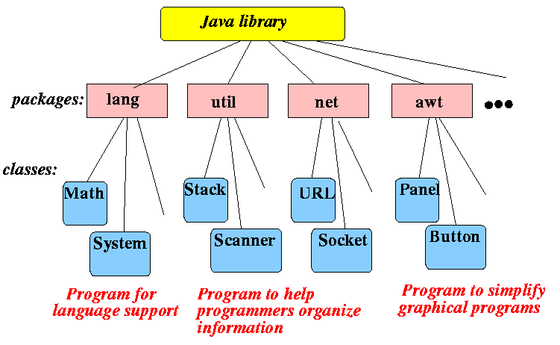
Packages
In Java, already many predefined packages are available those are to help programmers to develop their software in any easy ways.
E.g. java.swing ,java.lang-
All build in package are bundle called API bundled with the JDK

Slide 5
Simple example of java package
package mypack;
public class Simple
{
public static void main(String args[])
{
System.out.println("Welcome to package");
}
}

Slide 6
How to access package from another package?
There are three ways to access the package from outside
1. import package.*;
2.import package.classname;
3.fully qualified name.

Slide 7
Usingpackagename.*
File Name:-A.java
File Name:-B.java
package pack;
public class A
{
public void msg()
{
System.out.println("Hello");
}
}
package mypack;
import pack.*;
class B
{
public static void main(String args[])
{
A obj = new A();
obj.msg();
}
}

Slide 8
Using packagename.classname
File Name:-A.java
File Name:-B.java
package pack;
public class A
{
public void msg()
{
System.out.println("Hello");
}
}
package mypack;
import pack.A;
class B
{
public static void main(String args[])
{
A obj = new A();
obj.msg();
}
}

Slide 9
Using fully qualified name
File Name:-A.java
File Name:-B.java
package pack;
public class A
{
public void msg()
{
System.out.println("Hello");
}
}
package mypack;
class A
{
public static void main(String args[])
{
pack.A obj = new pack.A();
obj.msg();
obj1=new A ();
o A bj1.display();
}
void display()
{
}
}

Slide 10
Access Modifiers in java
There are 4 types of java access modifiers:
1.private
2.default
3.protected
4.public

Slide 11
Access Modifier
1) private access modifier
The private access modifier is accessible only within class.
2) default access modifier
If you don't use any modifier, it is treated as default by default. The default modifier is accessible only within package.
3) protected access modifier
The protected access modifier is accessible within package and outside the package but through inheritance only.
4) public access modifier
The public access modifier is accessible everywhere. It has the widest scope among all other modifiers

Slide 12
Access Protection
Access Modifier Access Location | Public | Protected | Default | Private
Same Class | Yes | Yes | Yes | Yes
Subclass in Same Package | Yes | Yes | Yes | No
Non Subclasses in same package | Yes | Yes | Yes | No
Subclass in Different Packages | Yes | Yes | No | No
Non Subclasses in Different packages | Yes | No | No | No

Slide 13
Multiple Inheritance
Java does not support multiple inheritance
Classes in Java can not have more than one superclass
E.g. class A extends B extends C
{
----------------
----------------
}
Is not permitted in Java
Large number of real life applications require the use of multiple inheritance
In C++ , implementation of multiple inheritance proves difficult and adds complexity to the language.
But Java provides an alternate approach known as interfaces to support the concept of multiple inheritance

Slide 14
Interface
Basically it is a kind of class
Like classes, interface contain methods and variables but with a major difference
Difference is that interfaces define only abstract methods and final fields
This means that interfaces do not specify any code to implement these methods and data fields contain only constants
Responsibility of the class that implements an interface to define the code for implementation of these methods.
Syntax for defining an interface is very similar to that for defining a class

Slide 15
Syntax for Interface
General form of an interface definition is
interface InterfaceName
{
variable declaration;
method declaration;
}
Interface is just keyword
Variables are declared as
static final type variablename= value;
Methods declaration will contain only a list of methods without any body statements
return type methodsname1 (parameter_list);
Intreface Area
{
final static float pi=3.142F;
float a_calculate ( float x, float y);
void show();
}

Slide 16
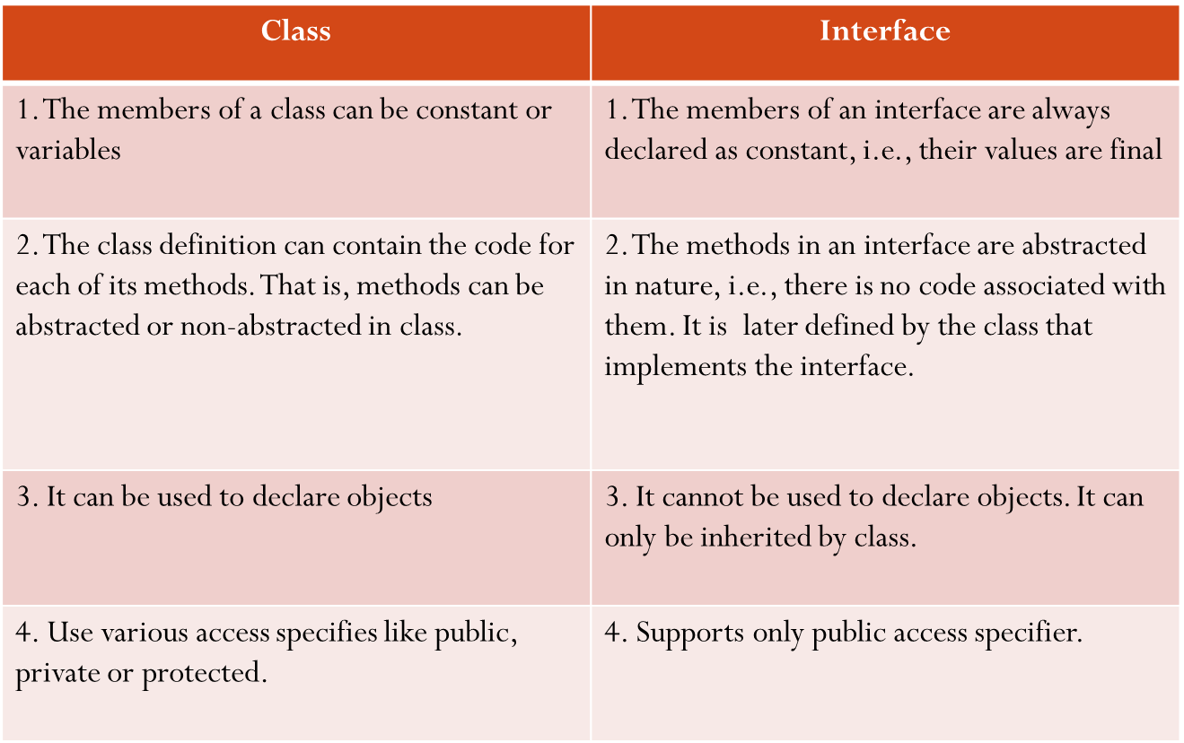
Difference Between Class and Interface

Slide 17
Extending Interface
As like classes, we can apply reusability concept on existing interface to create new interface.
That is, an interface can be sub-interfaced from existing interface.
So this existing interface is called superinterface.
The new subinterface will inherit all the characteristics of superinterface in the manner similar to subclass.
Syntax for this is:
interface name2 extends name1
{
body of name2;
}

Slide 18
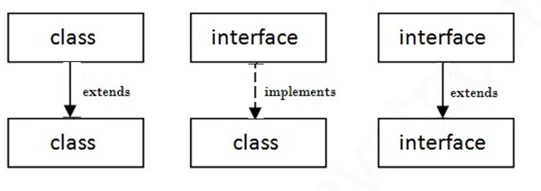
Extending Interface
interface Itemconstants
{
int code=1001;
string name=“Fan”;
}
interface Item extends ItemConstants
{
void display();
}
interface Itemconstants
{
int code=1001;
string name=“Fan”;
}
interface ItemMethods extends ItemConstants
{
void display();
}
Interfaces Item extends ItemConstants,ItemMethods
{
----------------
-----------------
}

Slide 19
Implementing Interfaces
Interfaces are used as “Superclasses” whose properties are inherited by classes.
Therefore necessary to create a class that inherits the given interface
Class classname implements interfacename
{
Body of classname
}
Class classname extends superclass
implements interfacename1,interfacename2,……..
{
Body of classname
}

Slide 20
Various forms of Interface Implementation
A
B
C
Interface
Implementation
Class
Extension
Class

Slide 21
Various forms of Interface Implementation
A
B
C
Interface
Implementation
Class
Extension
Class

Slide 22
Default Method in Interface
interface Drawable
{
void draw();
default void msg()
{
s.o.p("default method");
} }
class Rectangle implements Drawable
{
public void draw()
{s.o.p("drawing rectangle");
} }
class TestInterfaceDefault{
p.s.v.m.(String args[])
{
Drawable d=new Rectangle();
d.draw();
d.msg();
}
}

Slide 23
Static Method in Interface
interface Drawable
{
void draw();
static int cube(int x)
{return x*x*x;}
}
class Rectangle implements Drawable
{
public void draw()
{
s.o.p("drawing rectangle");
}
}
class TestInterfaceStatic
{
psvm(String args[])
{
Drawable d=new Rectangle(); d.draw();
s.o.p( Drawable.cube(3) );
}
}

Slide 24
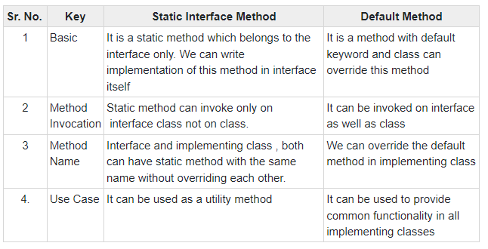

Slide 25
ABSTRACT CLASS | INTERFACE
1) Abstract class can have abstract and non-abstract methods. | Interface can have only abstract methods. Since Java 8, it can have default and static methods also.
2) Abstract class doesn't support multiple inheritance. | Interface supports multiple inheritance.
3) Abstract class can have final, non-final, static and non-static variables. | Interface has only static and final variables.
4) Abstract class can provide the implementation of interface. | Interface can't provide the implementation of abstract class.
5) The abstract keyword is used to declare abstract class. | The interface keyword is used to declare interface.
6) Example: public abstract class Shape{ public abstract void draw();} | Example: public interface Drawable{ void draw();}

